Slide 1
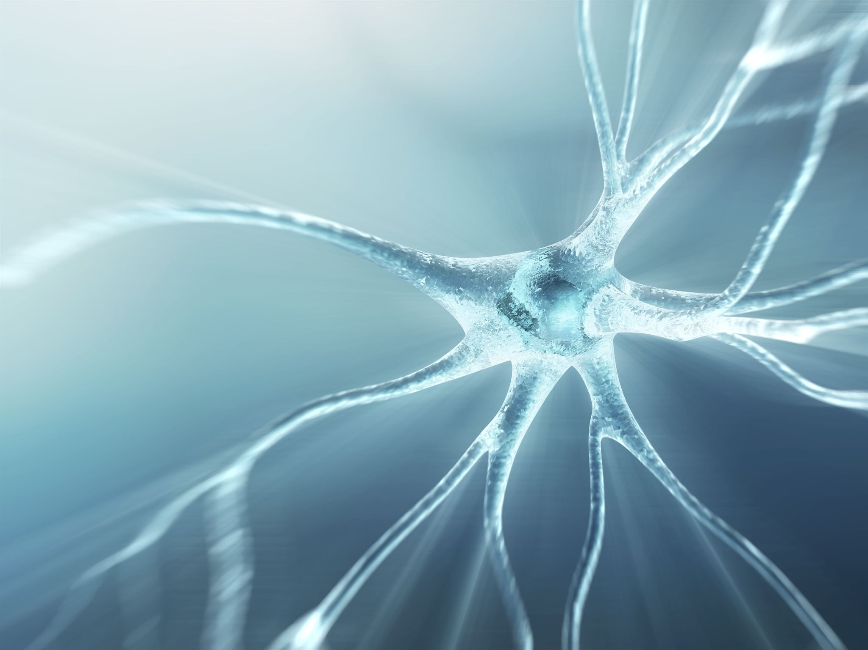
Neural Networks Introduction and Structure
Learn about Neural Networks
Understand the Structure of Neural Networks
Notes:
This presentation is about Neural Networks and their structure. In the following slides, we will discuss the basics of Neural Networks and the different components that make up their structure.

Slide 2

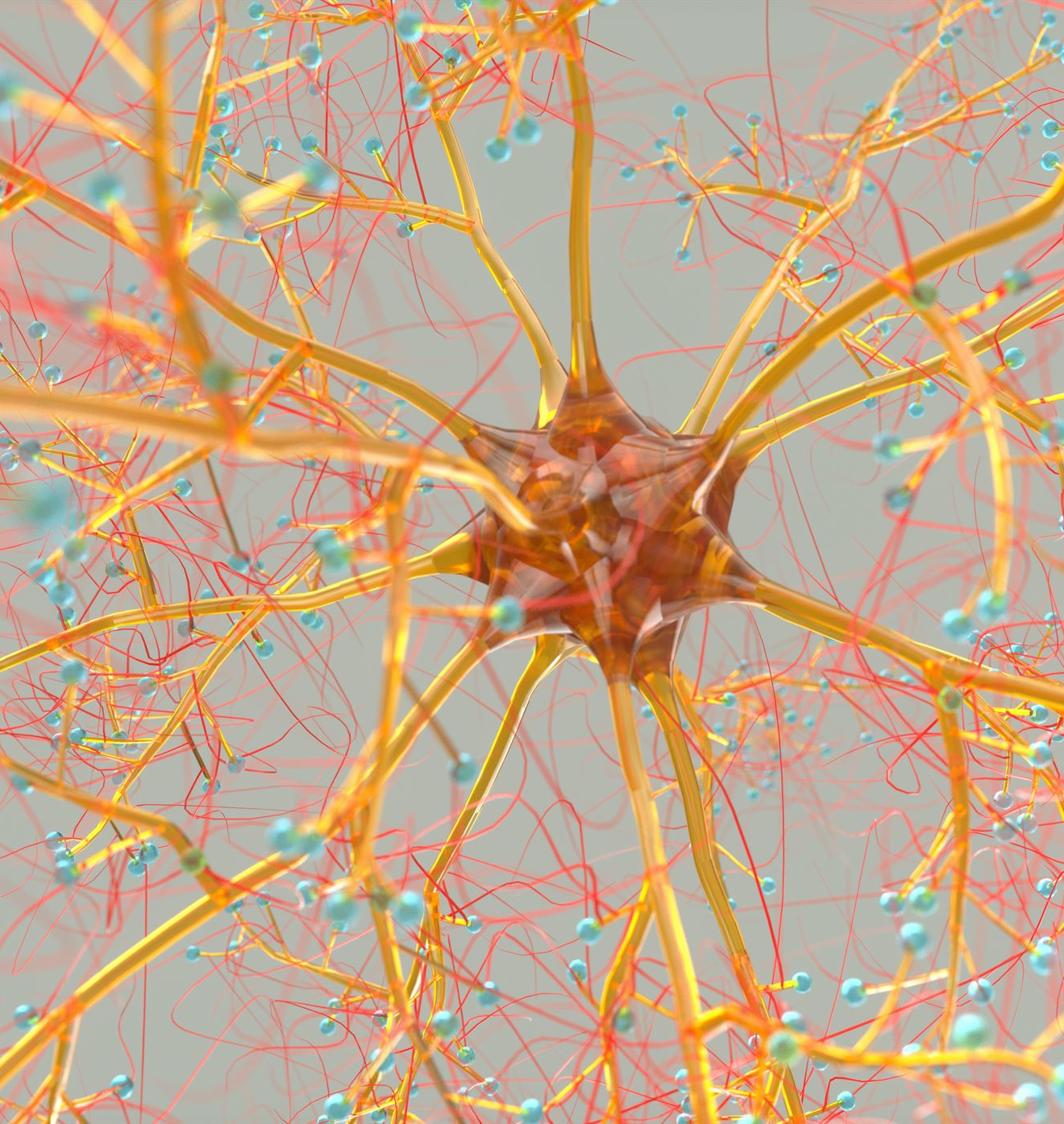
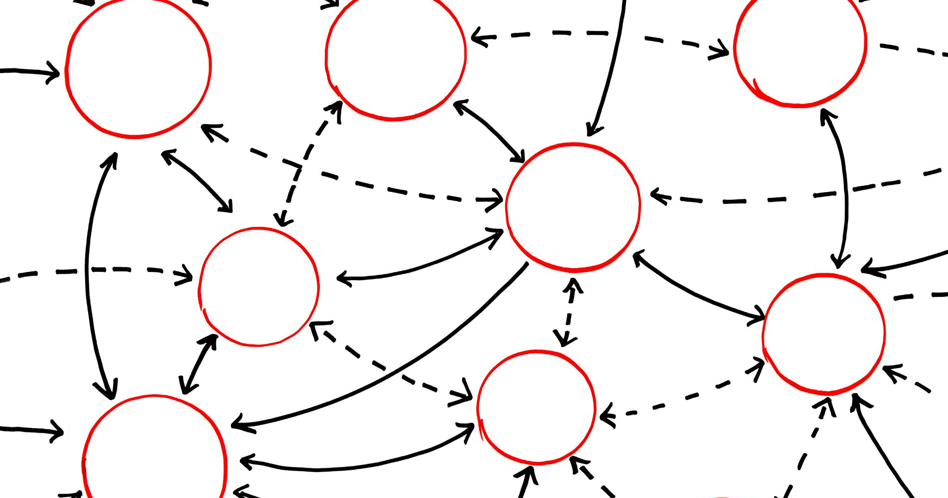
Agenda
Introduction to Neural Networks and Perceptron Model
Logistic Regression and Matrix Representation
Activation Functions
Building Neural Networks

Slide 3
Introduction to Neural Networks and Perceptron Model

Slide 4
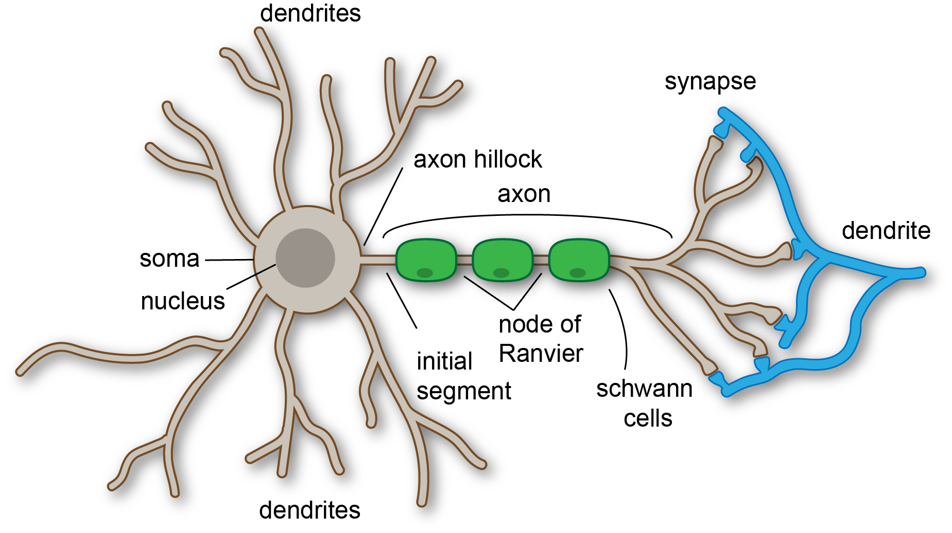
Neuron Cell and Its Function
Neuron cell has four main components: cell body, axon, synapse, and dendrites.
The cell body contains the nucleus and other organelles necessary for cellular function.
The axon is responsible for transmitting electrical impulses away from the cell body.
The synapses are the contact points between neurons that allow for communication and transmission of information.
The dendrites receive information from other neurons and pass it on to the cell body.
Neuron cells are essential for communication throughout the nervous system and the transmission of information throughout the body.
Notes:
Neuron cells are highly specialized cells that play a critical role in the nervous system. They are responsible for transmitting information throughout the body, allowing for communication between different parts of the body and the central nervous system. The four main components of a neuron cell are the cell body, axon, dendrites, and synapses. The cell body contains the nucleus and other organelles necessary for cellular function. The axon is responsible for transmitting electrical impulses away from the cell body, while the dendrites receive information from other neurons and pass it on to the cell body. Synapses are the contact points between neurons that allow for communication and transmission of information. These components work together to allow for the efficient transmission of information throughout the nervous system.

Slide 5
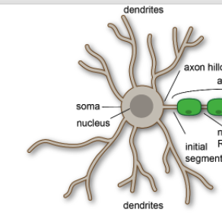

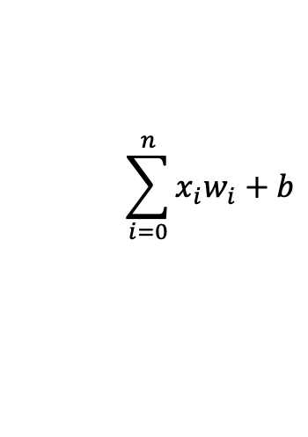

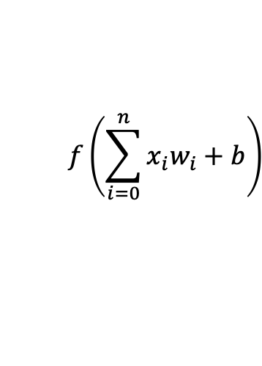


Functional Parts of Neuron and Their Relation to Perceptron Model
Cell Body → sum, bias, activation
Electrical impulse transmission from axon →pass (=)
Communication between neurons using synapses →weight multiplication
Information reception and processing in dendrites→ pass (=)
$$x_{0}$$
$$w_{0}$$
Axon from a Neuron
Synapse 0
Cell Body
$$x_{0}w_{0}$$
$$f\left(\sum_{i=0}^{n}{x_{i}w_{i}+b}\right)$$
Dendrite
Synapse 1
$$f$$
.
.
.
$$\sum_{i=0}^{n}{x_{i}w_{i}+b}$$
Output Axon
Activation Function
Synapse n
Notes:
The neuron cell is the building block of the nervous system, with four main components: cell body, axon, synapse, and dendrites. The axon is responsible for transmitting electrical impulses away from the cell body, while synapses allow for communication and information transmission between neurons. Dendrites receive information from other neurons and pass it on to the cell body for processing. This transmission and processing of information is similar to a perceptron model, a mathematical algorithm designed to perform tasks similar to the neural network of the brain.

Slide 6












Neuron: Perceptron Mathematical Model
$$w_{0}$$
Bias
$$1$$
$$w_{1}$$
$x_{1}, x_{2},…, x_{n}$ are input
Bias is a constant input
$w_{1}, w_{2},…, w_{n}$ are strengths/weights (Synapse)
Sum and activation: Cell Body
Output: Axon
Final Answer
$$x_{1}$$
$$w_{2}$$
Activation Function
$$x_{2}$$
$$Σ$$
Output
$$x_{3}$$
Inputs
.
.
.
$$w_{3}$$
$$x_{n}$$
$$w_{n}$$

Slide 7
Logistic Regression and Matrix Representation

Slide 8










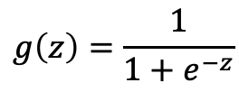
Neural Logistic Regression
Input
Logistic Regression
$$x_{1}$$
$$w_{1}$$
Output
$$z\left(x\right)=w_{1}x_{1}+w_{2}x_{2}+w_{3}x_{x}+w_{4}x_{4}+b$$
$$w_{2}$$
$$g\left(z\left(x\right)\right)$$
$$x_{2}$$
$$g\left(z\right)=\frac{1}{1+e^{−z}}$$
$$w_{3}$$
$$x_{3}$$
$$w_{4}$$
$$x_{4}$$
$w$: Feature Importance
Activation Function: Logistic Regression

Slide 9






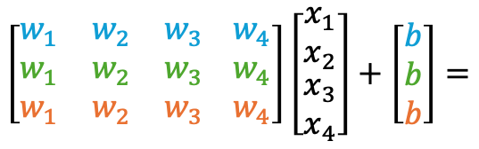










Neural Matrix Representation
Input Layer
Output Layer
A simple Neural Network
$$x_{1}$$
$$a_{1}$$
$$w_{1}$$
$$W$$
$$x$$
$$b$$
$$a$$
$$x_{2}$$
$$\left[\begin{matrix}w_{1} & w_{2} & w_{3} \\ w_{1} & w_{2} & w_{3} \\ w_{1} & w_{2} & w_{3}\end{matrix} \begin{matrix}w_{4} \\ w_{4} \\ w_{4}\end{matrix}\right]\left[\begin{matrix}x_{1} \\ x_{2} \\ \begin{aligned}x_{3} \\ x_{4}\end{aligned}\end{matrix}\right]+\left[\begin{matrix}b \\ b \\ b\end{matrix}\right]=$$
$$a_{2}$$
$$w_{2}$$
$$x_{3}$$
$$\left[\begin{matrix}w_{1}x_{1}+w_{2}x_{2}+w_{3}x_{3}+w_{4}x_{4} \\ w_{1}x_{1}+w_{2}x_{2}+w_{3}x_{3}+w_{4}x_{4} \\ w_{1}x_{1}+w_{2}x_{2}+w_{3}x_{3}+w_{4}x_{4}\end{matrix}\right]\overset{→}{activation}\left[\begin{matrix}a_{1} \\ a_{2} \\ a_{3}\end{matrix}\right]$$
$$w_{3}$$
$$a_{3}$$
$$x_{4}$$
$$w_{4}$$
$$f\left(Wx+b\right)=a (or y)$$

Slide 10
Activation Functions

Slide 11






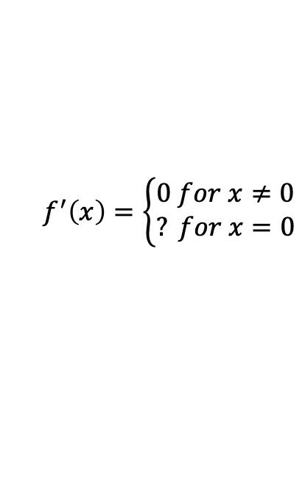

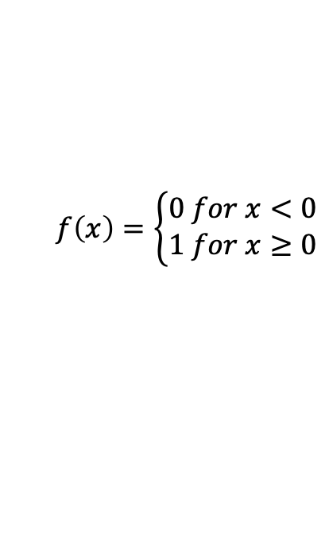
Neural Active Function
$$Binary Step$$
$$1.0$$
$$−2.5$$
$$0.0$$
$$2.5$$
$$f\left(x\right)=\left\{\begin{aligned}0 for x<0 \\ 1 for x≥0\end{aligned}\right.$$
$$f^{′}\left(x\right)=\left\{\begin{aligned}0 for x≠0 \\ ? for x=0\end{aligned}\right.$$
$$Equation$$
$$Derivation$$

Slide 12



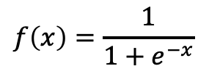
Neural Active Function
$$Logistic/Sigmoid$$
$$1.0$$
$$0.5$$
$$−2.5$$
$$0.0$$
$$2.5$$
$$f\left(x\right)=\frac{1}{1+e^{−x}}$$
$$f^{′}\left(x\right)=f\left(x\right)×\left(1−f\left(x\right)\right)$$
$$Equation$$
$$Derivation$$

Slide 13
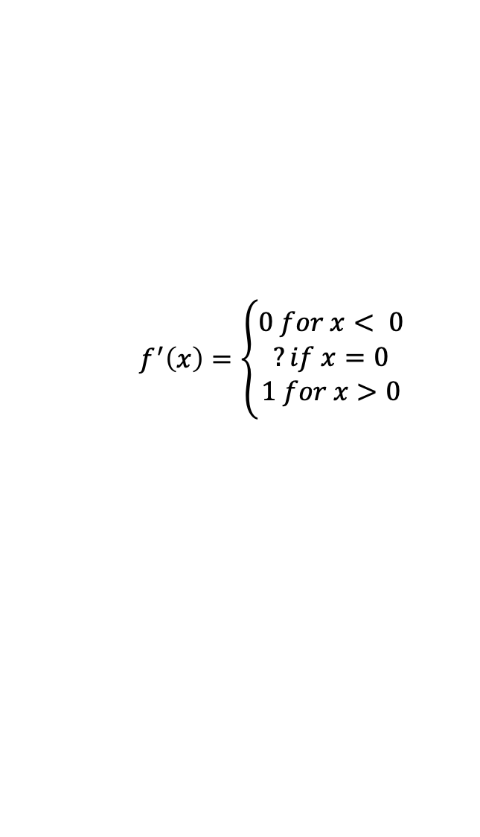
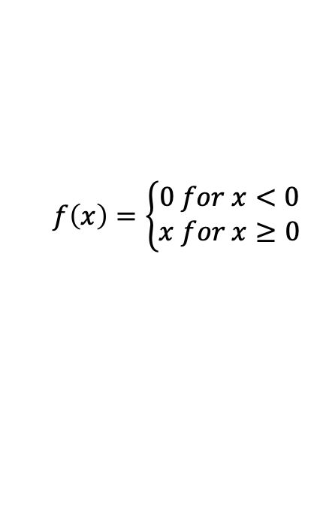

Neural Active Function
$$Rectified Linear Unit (ReLU)$$
$$1.0$$
$$0.5$$
$$−2.5$$
$$0.0$$
$$2.5$$
$$f^{′}\left(x\right)=\left\{\begin{aligned}0 for x< 0 \\ ?if x=0 \\ 1 for x>0\end{aligned}\right.$$
$$f\left(x\right)=\left\{\begin{aligned}0 for x<0 \\ x for x≥0\end{aligned}\right.$$
$$Equation$$
$$Derivation$$

Slide 14
Building Neural Networks

Slide 15
Build Up Neural Network

Slide 16
Neural Networks – One Layer – One Neuron
Neural Networks – Adding One Layer – Deep Learning
Input Layer
Input Layer
Output Layer
Hidden Layer
Output Layer
Input → Output – (4x1)
Input →Hidden→ Output – (4x3x1)

Slide 17
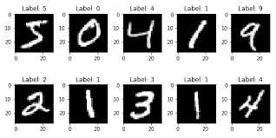







Neural Networks – Wider Network
Popular Network:
Early Image Recognition (MNIST)
784 Inputs (28x28 pixels)
16 Hidden neurons
10 Output neurons
784x16 weights between Inputs and Hidden
16x10 weights between Hidden and Output
0
$$x_{1}$$
Input Layer: 784
(28x28) neurons, each with values between 0 and 255
1
$$x_{2}$$
$$x_{3}$$
2
$$⋮$$
$$⋮$$
$$x_{784}$$
9
$$⋮$$
Hidden Layer:
16 hidden neurons
Output Layer:
10 classifiers for 10 digits

Slide 18
Neural Networks – Deep(er) Neural Networks
Definition:
More than1 hidden layer
More than 3 layers
Types:
Simple
Convolutional Neural Networks
Recurrent Neural Networks
Autoencoders
Output Layer
Input Layer
Hidden Layer 1
Hidden Layer 2

